Slide 1
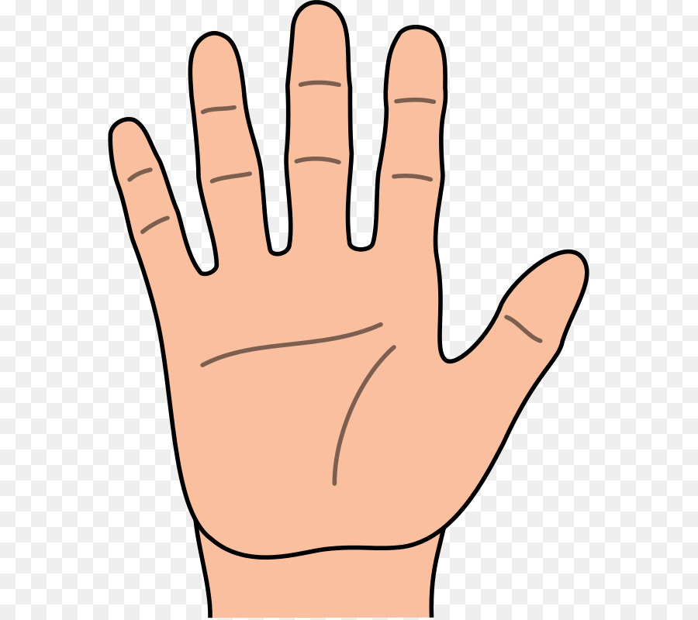
I wish
Success
Big
Everything
Everywhere

Slide 2
Theme: Heart and blood
vessels
Class: 8 grade
Biology teacher: Shakirov A. B

Slide 3
Teaching aims :
● Will be able todescribe the structure of the heart and blood vessels of a person.
● Will be able to establish blood vessels and functions.
● Can study the heart function.

Slide 4
The aids methods:
Interactive white board, presentation, Chess method, Traffic light method, association

Slide 5
Home task:
English | Русский | Қазақша
Leukocyte | лейкоцит | лейкоцит
Erythrocyte | эритроцит | эритроцит
Platelet | тромбоцит | тромбоцит
Immunity | иммунитет | иммунитет
Artificial | искусственный | жасанды
Natural | естественный | табиғи
Agglutination | агглютинация | агглютинация
Donor | донор | донор
Recipient | реципиент | қан алушы
Antibodiy | антитела | антидене
Phagocyte | фагоцитоз | фагоцитоз
Spleen | селезенка | көкбауыр
Plasma | плазма | плазма
Hemoglobin | гемоглобин | гемоглобин
Valve | клапан | қақпақша
Anemia | анемия | қаназдық

Slide 6
Home task:
English | Русский | Қазақша
Leukocyte
 |  | эритроцит
 | тромбоцит
 | иммунитет
Artificial
 |  | табиғи
Agglutination
 | донор
 |  | қан алушы
Antibodiy
 | фагоцитоз
 |  | көкбауыр
Plasma
 |  | гемоглобин
 | клапан
Anemia

Slide 7
Terminology stady
№ | Қазақша | English | Русский
1 | Жүрек | Heart | Сердца
2 | Камера | Chamber | Камера
3 | Жүрекше | Atria | Предсердие
4 | Қарынша | Ventricle | Желудочек
5 | Тамыр | Vessel | Сосуд
6 | Күретамыр | Artery | Артерия
7 | Көктамыр | Vein | Вена
8 | Қылтамыр | Capillary | Капилляр
9 | Лүпіл | Pulse | Пульс

Slide 8
Key terms
Heart, Vessel, Artery, Vein, Capillary, Pulse

Slide 9
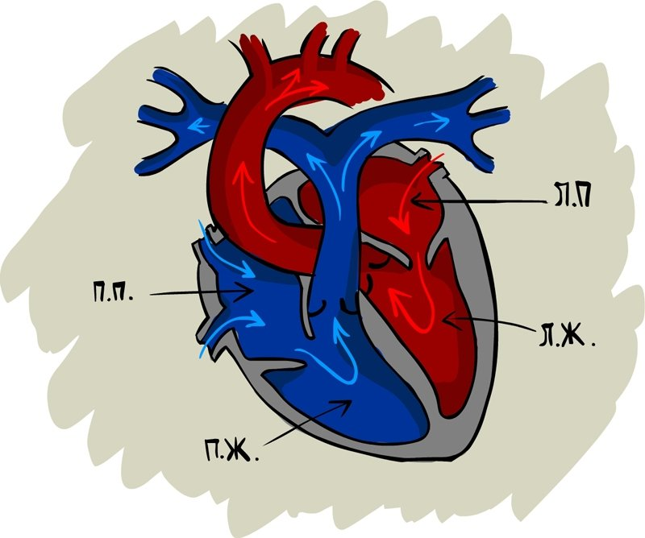
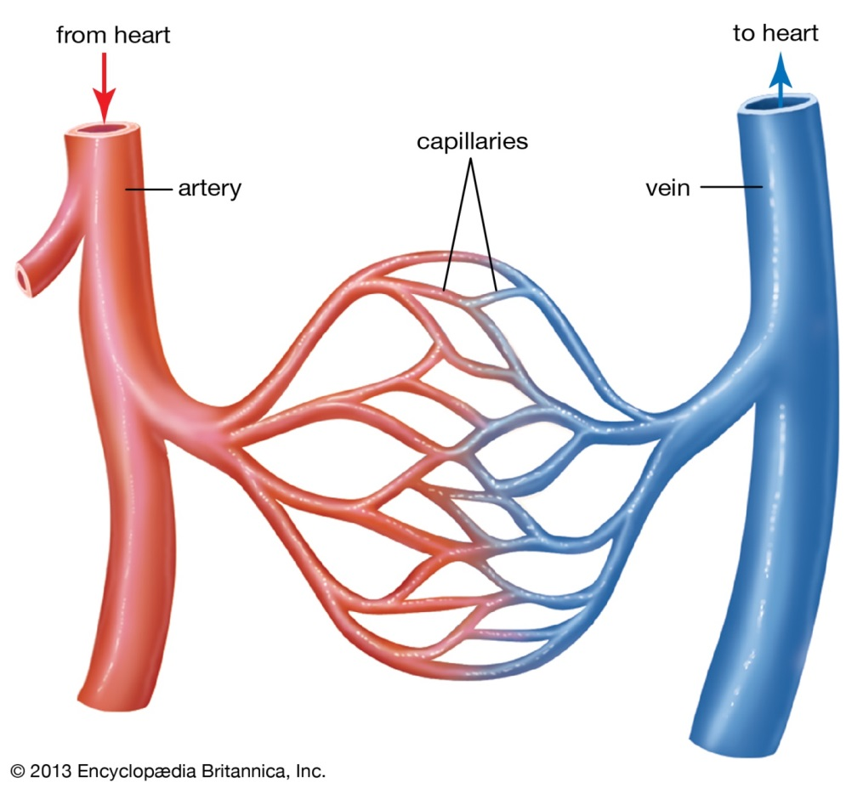
Theoretical unit
Circulatory system
HEART
BLOOD VESSELS
Left artrium
right artrium
left ventricle
right ventricle

Slide 10
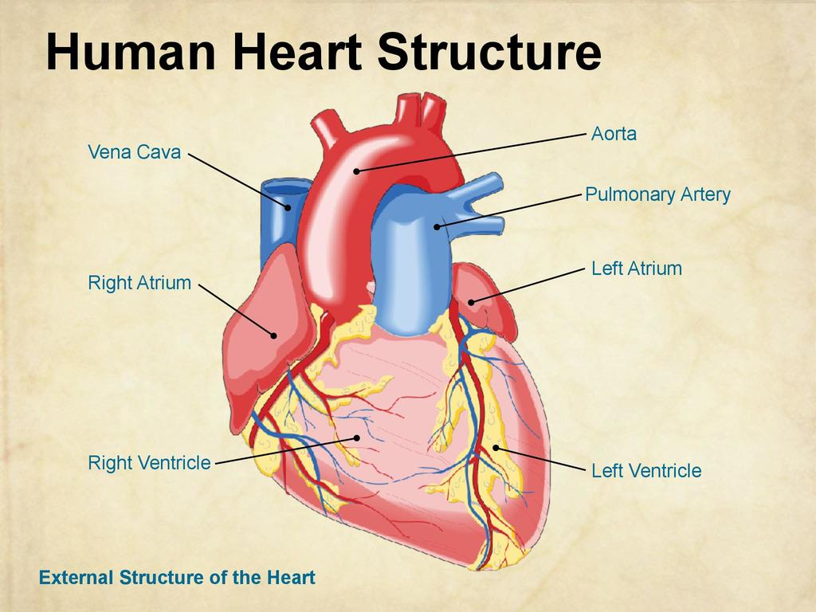
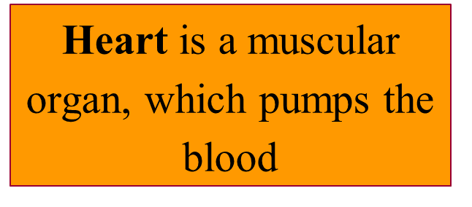

Slide 11
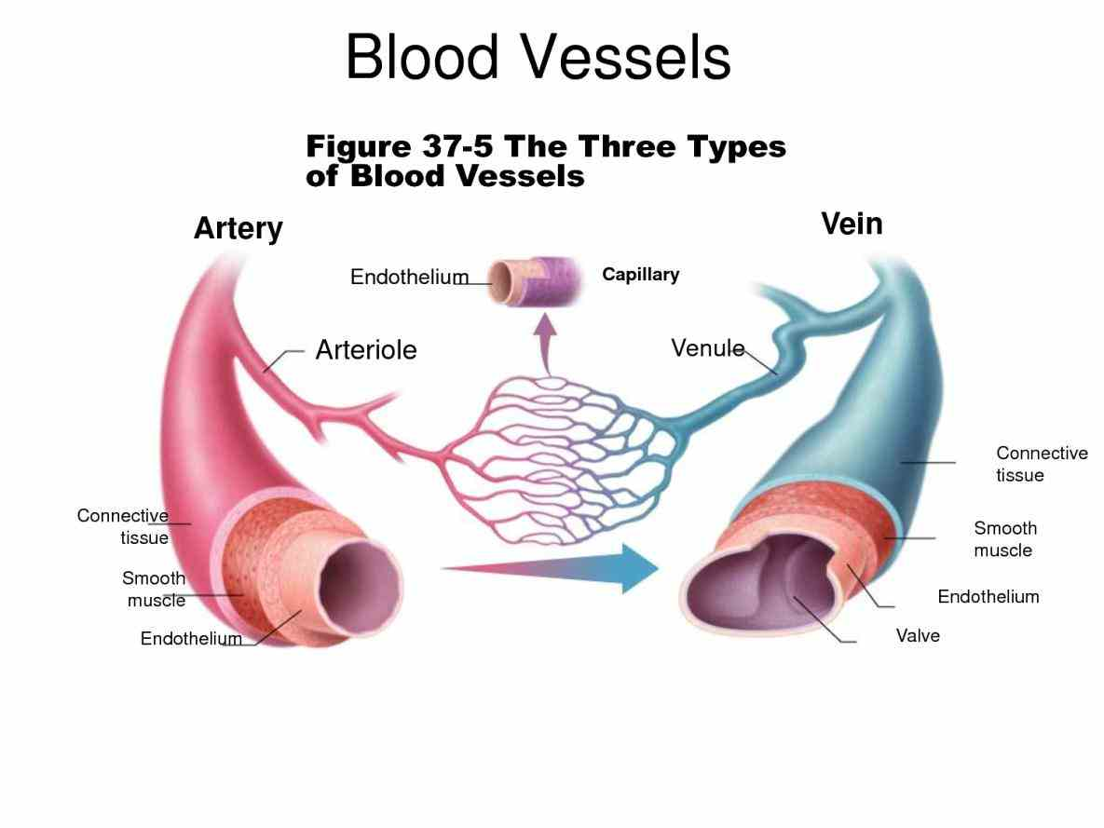
Arteries are blood vessels that transport blood from the heart;
Capillaries are blood vessels that connect arteries and veins;
Veins are blood vessels that transport blood to the heart.

Slide 12
Pulse is a rhythmic beating in the arteries caused by the beating of the heart.

Slide 13
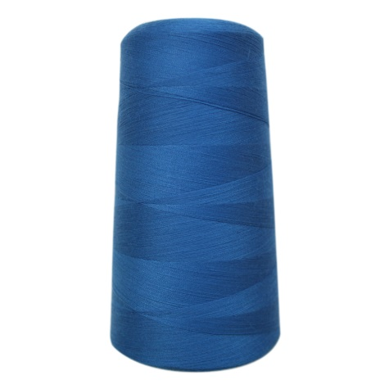
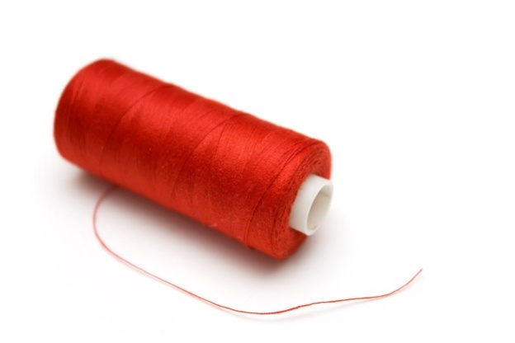
Activity 1
Using cаloured threads constructs models of open and closed circulatory system. Glue it to the paper and write all of the parts of circulatory systems.
С помощью цветных нитей строят модели открытой и закрытой системы кровообращения. Приклейте его к бумаге и напишите все части системы кровообращения.

Slide 15
Activity 2
Lab works
Working process:
1. Wish your index and middle finger, try to find your heart rate on the inside of the wrist.
2. Measure your heart rate for 6 seconds. Multiply the resulting number by 10 and write the result in the table below.
3. Do any exercise for 10 minutes.
4. Measure your heart rate for 6 seconds after both 1,3,5 and 10 minutes of physical activity.
5. Multiply your results by 10 and write the numbers in the table below.
Results:
Time | Pulse
At rest
1 minute
3 minute
5 minute
10 minute

Slide 16
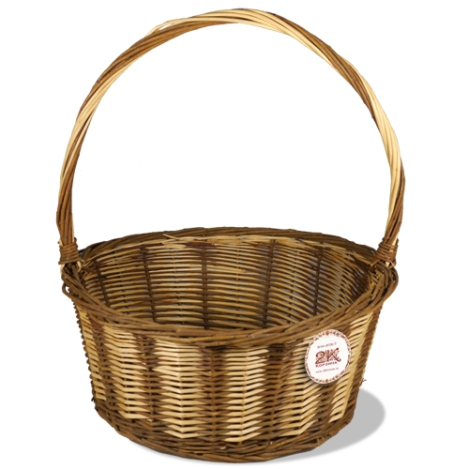
Reflection:
I Like
today’s
Lesson
I don’t
Like today’s
Lesson

